Slide 1
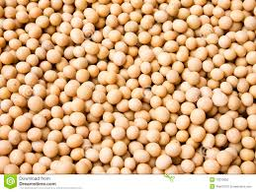
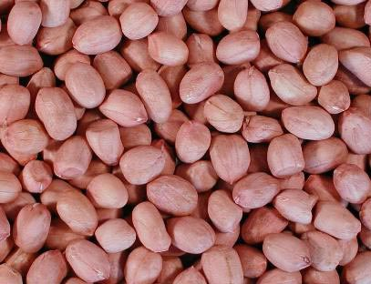
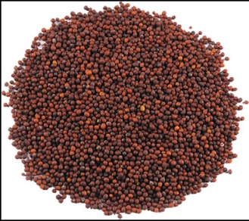
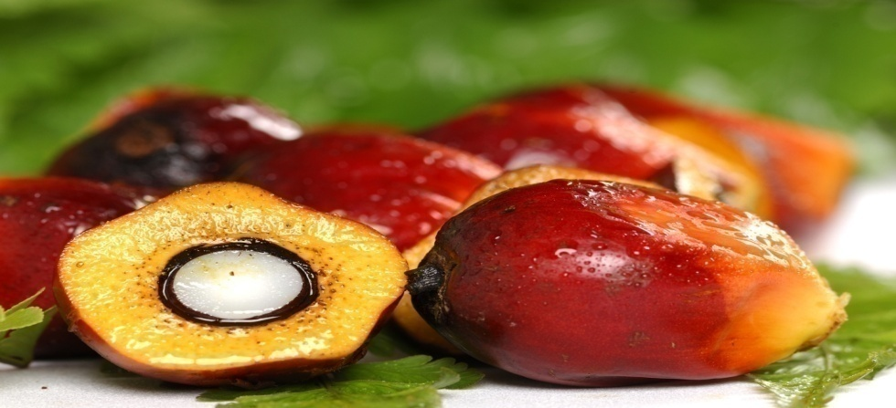
Oilseeds and Vegetable Oil Scenario
Oilseeds Division
DAC & FW

Slide 2
Top 10 Oilseed producing countries - 2014
Major oilseed producing countries | Oilseeds produced | Production (lakh tonnes | % share
USA | Soybean, Groundnut, Sunflower, Rapeseed | 1125.25 | 24
Brazil | Soybean, Groundnut | 871.64 | 18
Argentina | Soybean, Groundnut | 545.64 | 11
China | Groundnut, Rapeseed, Soybean, Sunflower, Castor | 419.64 | 9
India | Soybean, Groundnut, R&M, Sesame, Sunflower | 253.77 | 5
Canada | Rapeseed, Soybean | 216.04 | 5
Ukraine | Sunflower, Soybean, Rapeseed | 123.32 | 3
Russian Fed | Sunflower | 90.34 | 2
Paraguay | Soybean | 99.75 | 2
France | Rapeseed, Sunflower | 70.82 | 1
Others |  | 929.57 | 20
World Total (Source: FAO STAT) |  | 4745.78 | 100

Slide 3
Global scenario of Soybean - 2014
Country | Area (lakh ha) | Production (lakh tonnes) | Yield (kg/ha) | % share
USA | 336.14 | 1080.14 | 3213 | 35
Brazil | 302.74 | 867.61 | 2866 | 28
Argentina | 192.53 | 533.98 | 2774 | 17
China | 67.31 | 122.01 | 1813 | 4
India | 109.08 | 105.28 | 965 | 3
Others | 169.39 | 371.34 | 2192 | 12
World | 1177.19 | 3080.36 | 2620 | 100
Source: FAO STAT

Slide 4
Per day productivity of soybean
Country | Duration | Use of NPK (kg /ha) | Yield (kg /ha /day)
USA | 165 | 156.80 | 17.00
Brazil | 150 | 136.00 | 19.30
Argentina | 180 | N/A | 13.80
China | 150 | N/A | 12.20
India | 95 | 44.10 | 12.30
(Source: ICAR – Presentation)

Slide 5
Global scenario of Groundnut - 2014
Country | Area (lakh ha) | Production (lakh tonnes) | Yield (kg/ha) | % share
China | 45.22 | 157.83 | 3491 | 37
India | 52.00 | 65.57 | 1261 | 15
Nigeria | 27.70 | 34.13 | 1232 | 8
USA | 5.36 | 23.63 | 4407 | 6
Sudan | 21.04 | 17.67 | 840 | 4
Others | 105.48 | 124.33 | 1178 | 29
World | 256.70 | 423.16 | 1649 | 100
Source: FAO STAT

Slide 6
Global scenario of R & M - 2014
Country | Area (lakh ha) | Production (lakh tonnes) | Yield (kg/ha) | % share
Canada | 80.75 | 155.55 | 1926 | 22
China | 65.50 | 116.00 | 1771 | 16
India | 72.01 | 78.77 | 1094 | 11
Germany | 13.95 | 62.47 | 4479 | 9
France | 15.04 | 55.23 | 3673 | 8
Others | 118.65 | 327.17 | 2757 | 46
World | 365.90 | 716.42 | 1958 | 100
Source: FAO STAT

Slide 7
Global scenario of Sunflower - 2014
Country | Area (lakh ha) | Production (lakh tonnes) | Yield (kg/ha) | % share
Russian Fed. | 64.43 | 90.34 | 1902 | 22
Ukraine | 52.12 | 101.34 | 1944 | 25
China | 9.30 | 23.80 | 2559 | 6
Romania | 9.98 | 21.89 | 2194 | 5
India | 7.30 | 4.15 | 569 | 1
Others | 113.79 | 195.63 | 1719 | 47
World | 247.62 | 413.35 | 1669 | 100
Source: FAO STAT

Slide 8
National Oilseeds Scenario
Year | Area Lakh ha | Production Lakh tonnes | Yield Kg /ha
1950-51 | 107.30 | 51.60 | 481
1960-61 | 137.70 | 69.80 | 507
1970-71 | 166.40 | 96.30 | 579
1980-81 | 176.00 | 93.70 | 532
1990-91 | 241.50 | 186.10 | 771
2000-01 | 227.70 | 184.40 | 810
2010-11 | 272.20 | 324.82 | 1193
2011-12 | 263.10 | 298.00 | 1133
2012-13 | 264.84 | 309.39 | 1168
2013-14 | 285.25 | 328.76 | 1153
2014-15 | 257.26 | 266.75 | 1037
2015-16 ( 4th Est) | 261.34 | 253.04 | 968
Source: DES, DAC&FW

Slide 9
Crop wise contribution ( Avg. 2011-16)
Crops | Area (lakh ha) | Production (lakh tonnes) | Yield (kg/ha) | % Share in prod.
Soybean | 110.49 | 115.41 | 1045 | 39
R &M | 60.88 | 71.23 | 1170 | 24
Groundnut | 49.72 | 71.09 | 1430 | 24
Sesame | 17.89 | 7.81 | 436 | >2
Sunflower | 6.58 | 4.66 | 708 | <2
Niger | 2.90 | 0.90 | 311 | <1
Safflower | 1.83 | 1.04 | 568 | <1
Castor * | 11.95 | 19.01 | 1590 | 6
Linseed* | 2.99 | 1.46 | 488 | <1
All India | 265.23 | 292.62 | 1103 | 100
Source: DES, DAC & FW (* Non-edible)

Slide 10
State wise contribution (2015-16)
States | Area (lakh ha) | Production (lakh tonnes) | Yield (kg/ha) | % Share in prod.
Madhya Pradesh | 73.36 | 62.44 | 851 | 25
Rajasthan | 48.35 | 57.11 | 1181 | 23
Gujarat | 25.58 | 41.02 | 1603 | 16
Maharashtra | 41.93 | 23.75 | 566 | 9
West Bengal | 7.94 | 9.37 | 1181 | 4
Tamil Nadu | 4.12 | 9.19 | 2230 | 4
Andhra Pradesh | 9.14 | 8.73 | 955 | 3
Karnataka | 13.31 | 8.67 | 651 | 3
Uttar Pradesh | 12.92 | 8.63 | 658 | 3
Haryana | 5.28 | 8.49 | 1608 | 3
Telangana | 4.49 | 4.96 | 1105 | 2
Others | 14.92 | 10.68 | 716 | 5
Total (DES) | 261.43 | 253.04 | 968 | 100

Slide 11
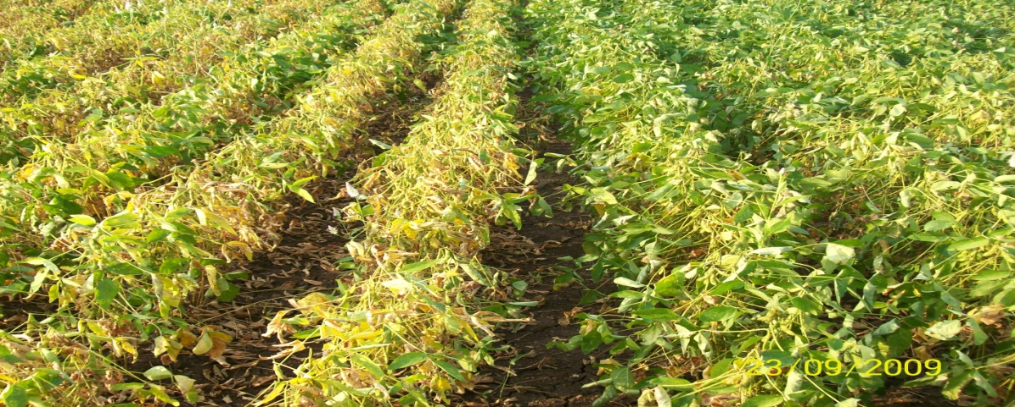
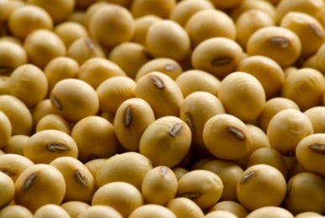
MAJOR SOYBEAN GROWING STATES (2015-16*)
States | Area lakh ha) | Production (lakh tonnes) | Yield (kg/ha)
MP | 59.06 | 49.08 | 831
Maharashtra | 37.74 | 21.01 | 557
Rajasthan | 12.05 | 9.99 | 829
Other states | 7.80 | 5.84 | 749
All India | 116.65 | 85.92 | 737
Source: DES, DAC & FW
1. Soybean (34%)
*4th Advance estimate

Slide 12
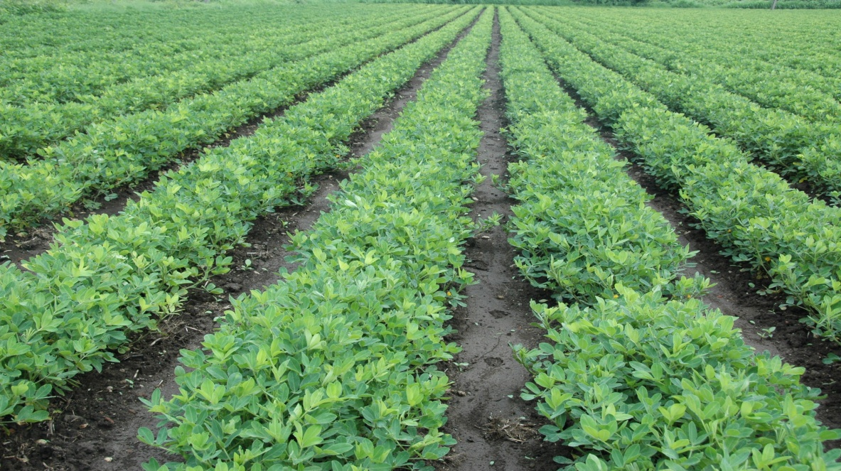
MAJOR GROUNDNUT GROWING STATES – 2015-16*
2. Groundnut (27%)
States | Area (lakh ha) | Production (lakh tonnes) | Yield (kg/ha)
Gujarat | 14.14 | 23.58 | 1668
A.P. | 7.75 | 8.02 | 1035
Telangana | 3.51 | 2.06 | 1622
Karnataka | 5.91 | 4.85 | 821
Rajasthan | 5.21 | 10.56 | 2028
Tamil Nadu | 3.52 | 8.82 | 2509
Other states | 5.51 | 9.86 | 1789
All India | 45.55 | 67.70 | 1486
Source: DES, DAC & FW
*4th Advance estimate

Slide 13
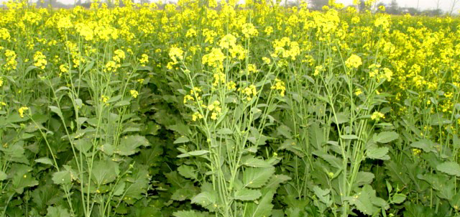
MAJOR MUSTARD GROWING STATES – 2015-16*
3. Rapeseed & Mustard (27%)
States | Area (lakh ha) | Production (lakh tonnes) | Yield (kg/ha)
Rajasthan | 25.49 | 32.69 | 1282
M.P | 6.17 | 7.00 | 1135
Haryana | 5.05 | 8.05 | 1594
U.P. | 5.93 | 6.02 | 1015
West Bengal | 4.58 | 4.99 | 1090
Other states | 10.4 | 9.47 | 911
All India | 57.62 | 68.22 | 1184
Source: DES, DAC & FW
*4th Advance estimate

Slide 14
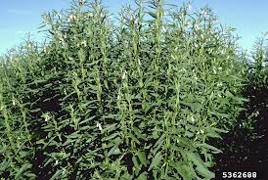
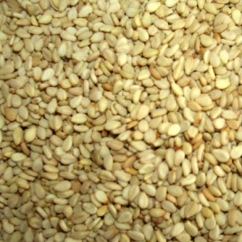
MAJOR SESAME GROWING STATES – 2015-16*
4. Sesame (>3%)
States | Area (lakh ha | Production (lakh tons) | Yield (kg/ha)
Rajasthan | 3.67 | 1.15 | 314
U.P. | 5.46 | 1.65 | 302
Gujarat | 1.66 | 0.67 | 404
M.P. | 3.65 | 1.97 | 540
West Bengal | 2.28 | 2.14 | 941
Other States | 2.75 | 1.08 | 393
All India | 19.47 | 8.66 | 445
*4th Advance estimate

Slide 15
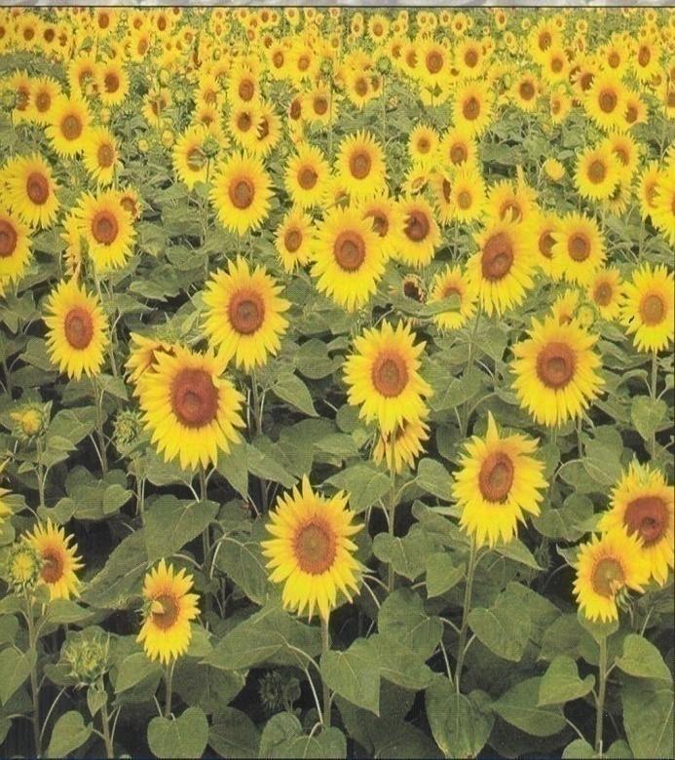
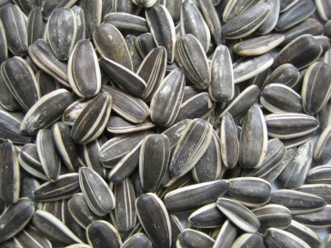
MAJOR SUNFLOWER GROWING STATES – 2015-16*
5. Sunflower (<2%)
States | Area (lakh ha) | Production (lakh tonnes) | Yield (kg/ha)
Karnataka | 3.28 | 1.65 | 503
A.P | 0.26 | 0.23 | 885
Maharashtra | 0.30 | 0.06 | 200
Others | 0.90 | 1.36 | 1511
All India | 4.74 | 3.30 | 697
Source: DES, DAC & FW
*4th Advance estimate

Slide 16
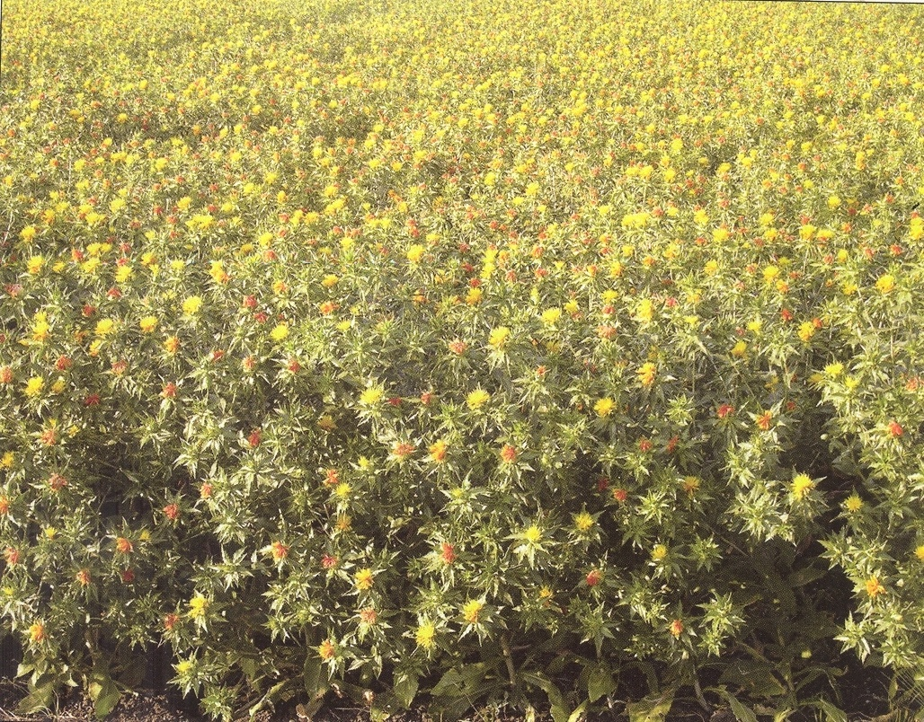
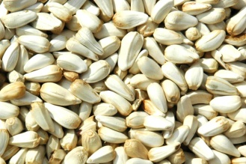
MAJOR SAFFLOWER GROWING STATES – 2015-16*
6. Safflower (<1%)
States | Area (lakh ha) | Production (lakh tonnes) | Yield (kg/ha)
Maharashtra | 0.74 | 0.16 | 213
Karnataka | 0.54 | 0.40 | 741
Others | 0.16 | 0.08 | 500
All India | 1.44 | 0.64 | 446
Source: DES, DAC & FW
*4th Advance estimate

Slide 17
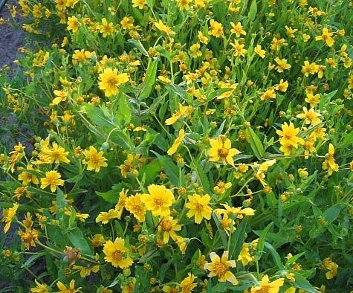
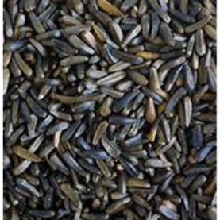
MAJOR NIGER GROWING STATES – 2015-16*
7. Niger (<1%)
States | Area (lakh ha) | Production (lakh tonnes) | Yield (kg/ha)
M.P. | 0.80 | 0.26 | 325
Odisha | 0.64 | 0.23 | 353
Chhattisgarh | 0.61 | 0.10 | 160
Maharashtra | 0.14 | 0.03 | 214
Others | 0.33 | 0.15 | 455
All India | 2.52 | 0.77 | 306
*4th Advance estimate

Slide 18
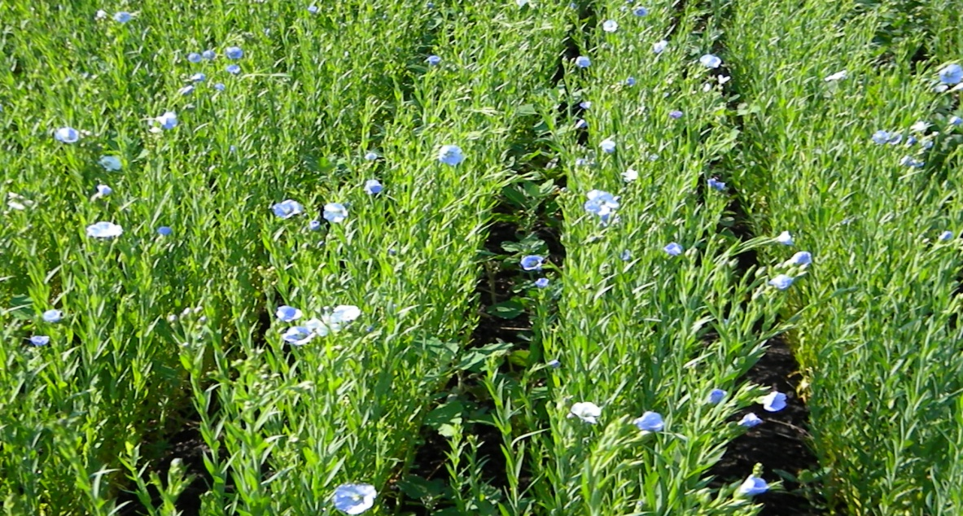
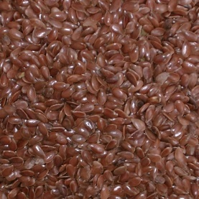
MAJOR LINSEED GROWING STATES – 2015-16*
8. Linseed (<1%)
States | Area (lakh ha) | Production (lakh tonnes) | Yield (kg/ha)
M.P. | 1.16 | 0.55 | 471
Maharashtra | 0.16 | 0.03 | 188
Uttar Pradesh | 0.17 | 0.08 | 460
Chhattisgarh | 0.27 | 0.08 | 292
Odisha | 0.10 | 0.05 | 480
Others | 1.12 | 0.53 | 473
All India | 2.98 | 1.32 | 442
*4th Advance estimate

Slide 19
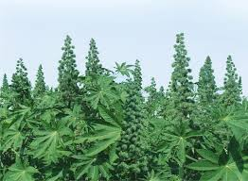
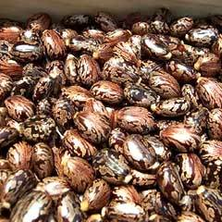
MAJOR CASTOR GROWING STATES – 2015-16*
9. Castor (>6%)
States | Area (lakh ha) | Production (lakh tonnes) | Yield (kg/ha)
Gujarat | 7.02 | 13.13 | 1870
Rajasthan | 1.91 | 2.70 | 1410
A.P | 0.51 | 0.29 | 569
Others | 0.93 | 0.38 | 409
All India | 10.37 | 16.50 | 1591
*4th Advance estimate

Slide 20
Yield potential (Kg/ha) in oilseeds
Crop/Season | World Avg. (2003-06) | National Avg. (2007-12) | FLD (2009-12) | Highest State Average
Groundnut -K | 1573 | 1167 | 1821 | 2202 – TN-2011-12
Groundnut –R/S |  | 1849 | 2432 | 3751 – TN-2011-12
Soybean - K | 2278 | 1166 | 1627 | 1966 – AP-2007-08
Rapeseed Mustard | 1708 | 1128 | 1841 | 1869 – Har-2010-11
Sunflower-R | 1242 | 760 (R) | 1453 (R) | 2286-UP-2009-10
Castor | - | 1454 | 2798 | 2054 – Guj.-2011-12
Sesame | 441 | 387 | 651 | 918 –WB-2011-12
Linseed | 872 | 413 | 981 | 889 – Bihar-2010-11
Source: FAO STAT, ICAR-FLD and DES, DAC&FW

Slide 21
Success stories
State | Crop | Technologies/Incentives
Gujarat | Groundnut | Sprinkler irrigation - Rabi- 2015
Maharashtra | Soybean | Supply of >3000 Ridge/Furrow maker lead to >40% area coverage under Ridge/Furrow /BBF - Kharif - 2014
Maharashtra | Soybean | Large scale inter-cropping of soybean with arhar over an area of >2 lakh ha - Kharif – 2015
UP | Sesame | Top of subsidy of Rs. 88/- per kg given by the State Government lead to area expansion of >1 lakh ha in Bundelkhand region of UP – Kharif - 2015

Slide 22
MSP and market price of oilseed
Crops | 2015-16 | 2016-17 | Average Market price – 2015-16
 |  |  | State | Price during peak season (Rs./qtl.)
 |  |  |  | Month | Price
Soybean (Y) | 2600 | 2775 | MP, Maha, Raj | Oct-Dec | 3529-3608
Groundnut | 4030 | 4220 | AP, Guj, TN | Oct-Dec | 5622-6209
Mustard | 3350 | * | Har., MP, Raj., UP | Mar-Apr | 3473-3758
Sesame | 4700 | 5000 | All India** | Oct-Nov | 5899-5956
Sunflower | 3800 | 3950 | AP, Karn, Maha | Oct-Dec | 3505-4172
* Yet to be announced . Source: **Trade Division

Slide 23
Oil Industry - at a Glance
Type of Mill | No. of Units | Annual capacity (million tonnes) | Capacity utilization (%)
Oil Mills (crushing units) | 15000 | 36.00 | 20-30
Solvant Extraction Plants | 600 | 31.00 | 40
Refineries | 650 | 20.00 | 50
Vanaspati | 250 | 3.00 | 40
Source: Solvant Extractors Association of India

Slide 24
Major Constraint in yield improvement
Continued dependence on rainfed production system leading to larger fluctuation in area and yield with more variation in groundnut.
Shorter crop duration and lack of hybrids.
Farmer’s priority to cereals under irrigated condition due to assured buy back
Growing import depressing domestic market and production.
Inability of states to provide matching share of 40% by General Category and 10% by NE & Hill.

Slide 25
STRATEGIES
Diversification of area from low yielding cereals and use of rice-fallows.
Intercropping of oilseeds with pulses / cereals
Liberal support for protective irrigations & mechanization for promotion of potential technologies.
Increasing SRR with varietal replacement.
Enhancing procurement of oilseeds.
Processing support in new/non-traditional areas.

Slide 26
Production Targets of Oilseeds
(Qty. in million tonnes)
Oilseeds | Highest production 2013-14 | Short Term 2021-22 | Medium Term 2026-27 | Long Term 2030-31
Soybean | 11.86 | 16.50 | 18.50 | 20.00
Groundnut | 9.71 | 10.75 | 11.25 | 12.00
R & M | 7.88 | 9.75 | 11.25 | 12.00
Sesame | 0.72 | 1.10 | 1.35 | 1.50
Others * | 2.58 | 4.00 | 4.50 | 5.00
Total | 32.75 | 42.10 | 46.85 | 50.50
* includes sunflower, safflower, niger, linseed and castor

Slide 27
Global consumption of vegetable oils– 2014-15
Name of oil | Qty. ( in MMT)
Palm oil | 60.73
Soybean oil | 46.79
Canola oil (Rapeseed) | 27.00
Sunflower oil | 15.18
Others | 23.57

Slide 28
Per capita consumption of vegetable oils
Country | Qty. (Kg per annum)
World | 17.00
USA | 36.00
India | 13.92
WHO | 18.00

Slide 29
CONSUMPTION OF VEGETABLE OILS (2014-15)
Source | Crop / Commodity | Qty. in lakh tonnes
Primary source | Soybean, groundnut, R&M, sesame, sunflower, safflower, niger, linseed. (includes castor oil of 7.48 lakh tonnes) | 63.29
Secondary source | Coconut, Palm oil, Cotton seed, Rice bran, TBOs , SE Oils | 32.46
Total |  | 95.75
Imported edible oil | Palm oil, Soybean, Sunflower, R&M | 145.88
Consumption | - | 241.63
Source - SEA Data Bank

Slide 30
COMMODITY-WISE SHARE IN EDIBLE OIL - 2014-15
Source | Availability | Import | Total | % share
Primary sources (Qty. in lakh qtls.)
R & M | 19.56 | 3.54 | 23.10 | 10
Soybean | 16.84 | 29.83 | 46.67 | 19
Groundnut | 15.08 | 0 | 15.08 | 6
Sunflower | 1.40 | 15.42 | 16.82 | 7
Sesame, Safflower, Niger | 3.02 | 0 | 3.02 | 1
Castor & Linseed | 7.39 | 0 | 7.39 | 3
Secondary sources (Qty. in lakh qtls.)
Palm oil | 1.71 | 97.09 | 98.80 | 41
Cotton seed oil | 12.15 | 0 | 12.15 | 5
Rice bran | 9.20 | 0 | 9.20 | 4
Others | 9.40 | 0 | 9.40 | 4
Total A+B | 95.75 | 145.88 | 241.63 | 100

Slide 31
QUANTITY & VALUE OF IMPORTED EDIBLE OIL
Oil year (Nov-Oct) | Import of edible oil (Qty. in lakh tonnes) | Value ( in 000 crores)
2011-12 | 84.45 | 46,260
2012-13 | 106.95 | 62,641
2013-14 | 118.07 | 69,759
2014-15 | 144.03 | 67,700
Source : DGCIS

Slide 32
Trend in import of edible oil
More than 14 million tonnes of vegetable oils worth of more than Rs. 67,000 crores (2014-15).

Slide 33
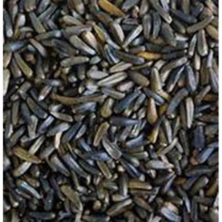
Export from Oilseeds sector – 2014-15
Commodity | Qty. (lakh tonnes) | Value (Rs. in crores)
Oil meal | 39.04 | 8128.60
Groundnut (HPS )* | 7.08 | 4675.38
Castor oil | 5.46 | 4710.18
Sesame seeds | 3.76 | 4717.77
Niger seeds | 0.18 | 108.23
Others | 2.89 | 1714.90
Total | 58.41 | 24055.06
*HPS: Hand picked selection

Slide 34
Major exporting and importing countries
Commodity | Exporting Countries | Importing Countries | India’s Position
Groundnut | Argentina, Brazil, India | China and EU including UK | largest Exporter
Palm oil | Indonesia, Malaysia | India, China, EU and Pakistan | largest Importer
Soybean oil | Argentina, Brazil, Paraguay | India, China | largest Importer
Sunflower Oil | Ukraine and Russia | India, China, Turkey and Netherland | largest Importer
Mustard oil | Canada, Germany, Poland | US, China and India | largest Importer
Sesame seed | India, Myanmar, Sudan | EU including UK | largest Exporter
Castor oil | India and China | China | largest Exporter

Slide 35
THANK YOU

